Slide 1
Category review: Chips
Retail Analytics
By Siyam Dodhia

Slide 2
Notes:
To view Privacy video explaining how important data privacy is to Quantium, please click here: https://www.youtube.com/watch?v=Zq1QDAkoRzU
or here Q:\Company Reference\Brand & Design\Brand videos\Q Privacy.mp4
At Quantium, we believe that data is the behavioural footprint of humanity and that it has to be treated with the utmost care and responsibility.
Histories, attitudes, indeed lives are stored within it in ways that aren’t always apparent – and that’s what makes its potential so powerful.
To work with it responsibly, sensitively, we set ourselves the highest data privacy protection and governance standards.
We have spent 17 years perfecting privacy-by-design and secure-by-design principles. Central to this is not holding any personally identifiable information about people –
we neither receive it, and put the necessary protections in place to be unable to decipher it.
Every aspect of handling data is safeguarded: from its de-identification, to its encryption – data security is paramount and of the highest grade.
We pride ourselves on gaining the trust of iconic organisations around the world through years of securely working with their data,
and in turn the trust that builds with their stakeholders.

Slide 3
Executive summary
01
Task 1
Sales spike in December
Older and Young families buy more average units of chips per customer segment.
Mainstream Midage and Young Singles/Couples are more willing to pay more per packet of chips.
Mainstream Young Singles/Couples are the target segment as they pay a higher average price per unit of chips.
02
Task 2
Store 77 saw a significant improvement in sales and number of customers from the new layout trial

Slide 4
01
Category
Give a better understanding about the types of customers who purchase Chips and their purchasing behaviours.
Examine transaction data
Examine customer data
Data analysis and customer segments
Deep dive into customer segments

Slide 5
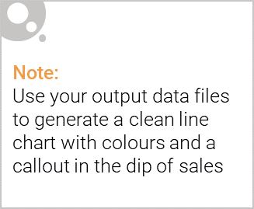
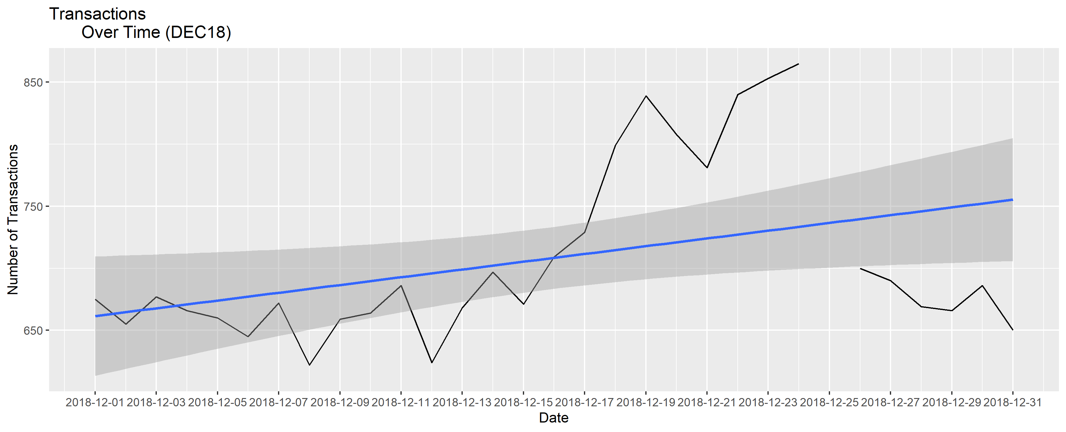
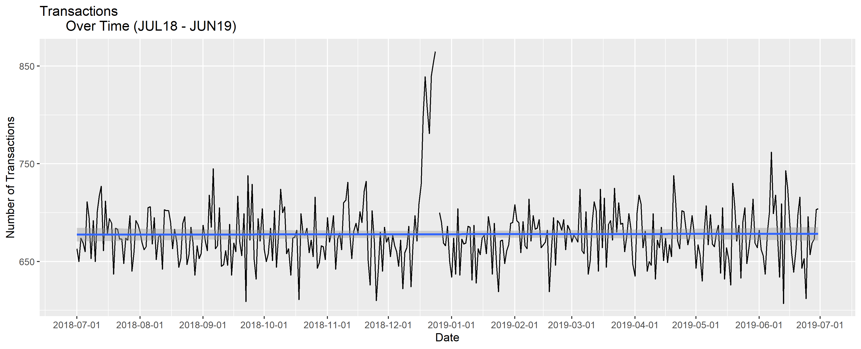
Sales over 2018/19 Financial Year
Transactions in December Spike
Due to Christmas, there is a spike in December chip purchases as people are buying more for family/Christmas events with all stores being closed on 25th December. This time period could be used to supply more premium brands.
R Studio Code: Lines 17 – 111

Slide 6
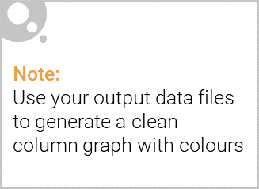
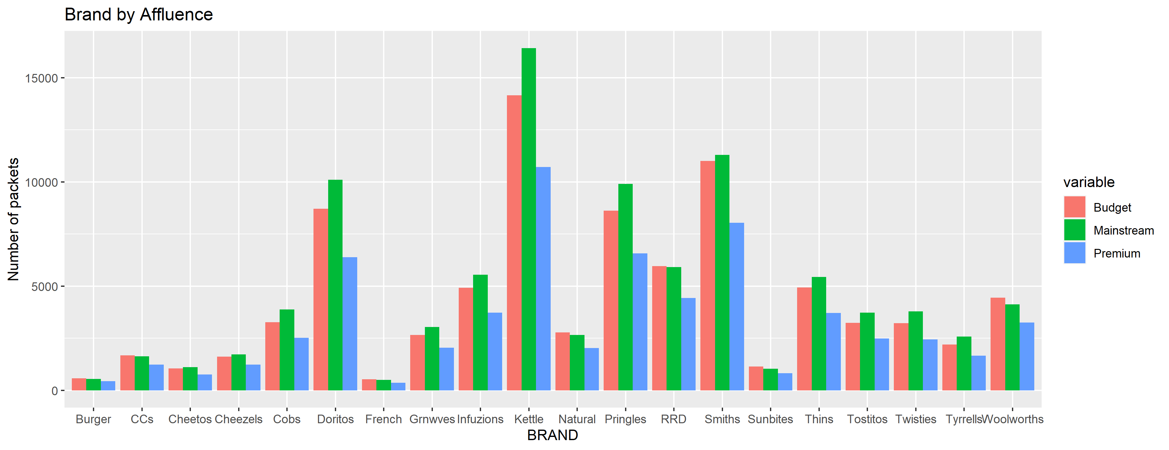
Affluence and its effect on consumer buying for the category of chips
Mainstream has the highest number of customers with 29245 customers and contribute to the highest total sales ($700865.40) and chips packet purchases (180780 packets). Budget and Premium then have 24470 and 18922 customers, respectively.
From the graph below we can see that ‘Kettle’ chips is the most popular brand between all 3 customers categories and ‘Smiths’ being the second most popular brand.
R Studio Code: Lines 115 – 338

Slide 7
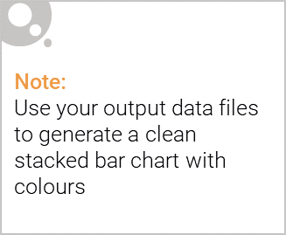
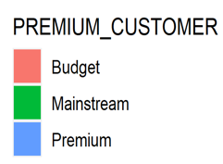
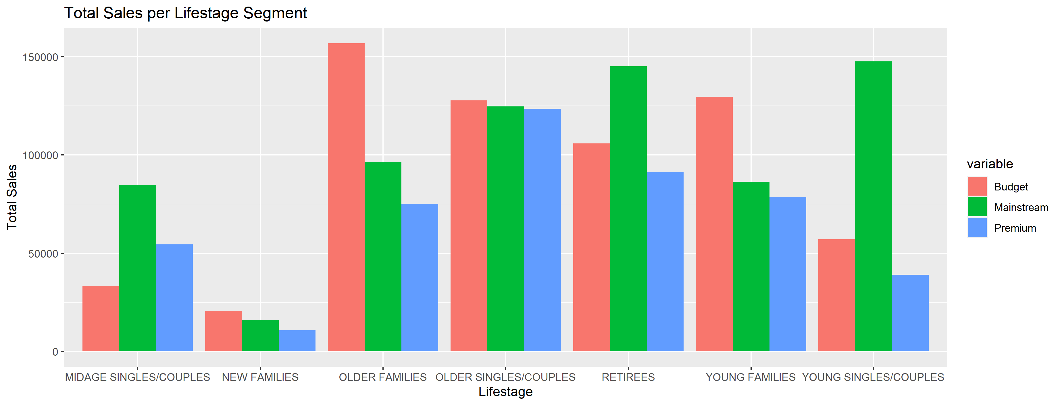
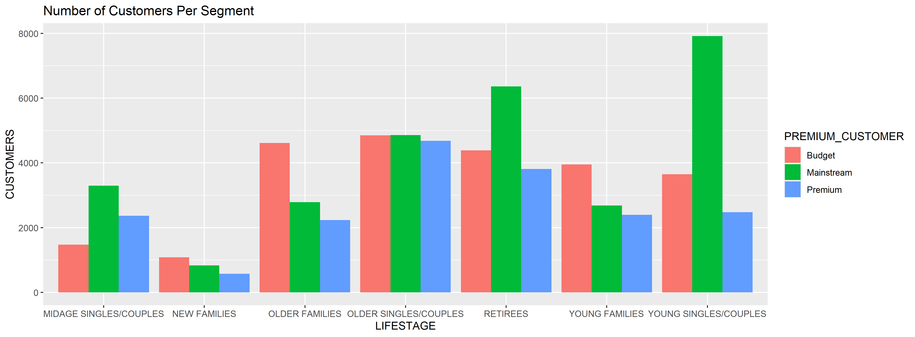
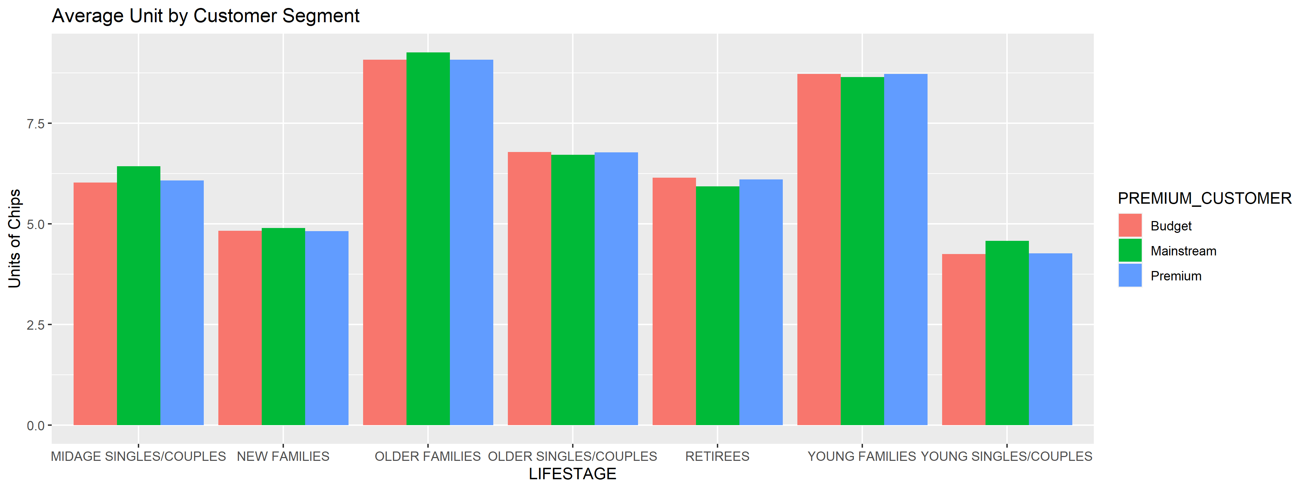

Editable (delete this)
Affluence and Life Stage effect on category of chips
Older Families and Young Families in general buy more chips per customer
Summary:
Sales are mainly coming from Budget Older Families, Mainstream Young Singles/Couples, and Mainstream Retirees (chart1). However, there are more Mainstream Young Singles/Couples and Retirees who buy chips which contribute to there being more sales but there is no major driver for the Budget Older Families segment (chart2).
Higher sales for Older Families could be due to more units of chips being bought per customer as seen (chart3). In general, Older and Young Families tend to buy more chips per customer.
Chart1: Total Sales Per Segment
Chart2: Number of Customers Per Segment
Chart3: Average Unit by Customer Segment
R Studio Code: Lines 342 – 495

Slide 8
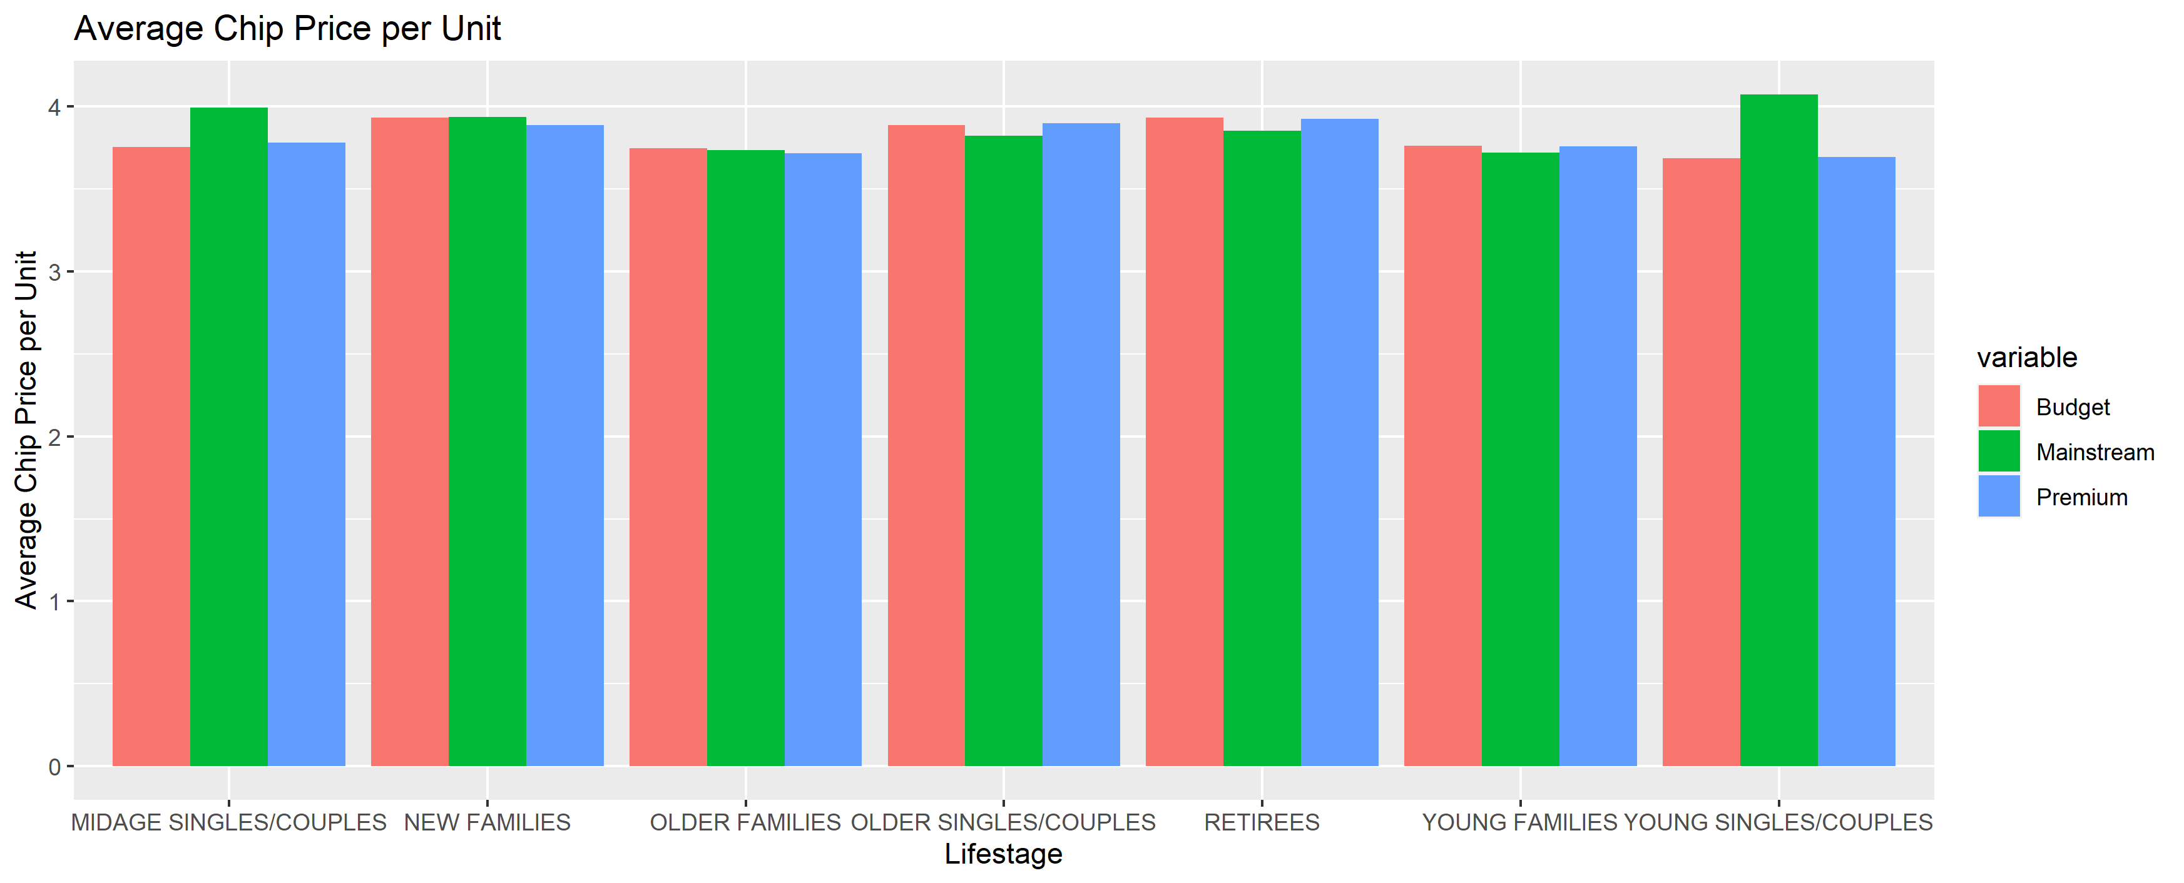
Editable (delete this)
Affluence and Life Stage effect on category of chips
Mainstream Mid Age and Young Singles/Couples pay more per packet of chips
Summary:
Mainstream Mid age and Young Singles/Couples are more willing to pay more per packet of chips compared to their budget and premium counterparts (Chart4). This may be due to premium shoppers being more likely to buy healthy snacks and when they buy chips, this is mainly for entertainment purposes rather than their own consumption. This is also supported by there being fewer Premium Mid Age and Young Singles/Couples buying chips compared to their Mainstream counterparts(Chart5).
Chart4: Average Chips Price Per Unit
Chart5: Number of Customers Per Segment
R Studio Code: Lines 342 – 495

Slide 9
Editable (delete this)
Target Segments Affinity
Mainstream Young Singles/Couples have a preference towards “Tyrrells” brand and “270g” pack size
Table 1
Table 2
Summary
BRAND | AFFINITY TO BRAND
Tyrrells | 1.2270252
Twisties | 1.2175057
Doritos | 1.2133968
Kettle | 1.1886666
Tostitos | 1.1841000
Pringles | 1.1810898
Cobs | 1.1609586
Infuzions | 1.1266217
Thins | 1.0562172
Grain waves | 1.0528955
Cheezels | 0.9506530
Smiths | 0.7758106
French Fries | 0.6917242
Cheetos | 0.6831501
RRD | 0.6520805
Natural | 0.6330910
CCs | 0.6061417
Sunbites | 0.5033981
Woolworths | 0.4943759
Burger Rings | 0.4475745
PACK SIZE (g) | AFFINITY TO PACK SIZE
270 | 1.2696083
380 | 1.2508271
330 | 1.2022433
110 | 1.1864916
134 | 1.1810898
210 | 1.1700202
135 | 1.1420863
250 | 1.1159594
170 | 1.0052999
150 | 0.9664487
175 | 0.9393354
165 | 0.9036286
190 | 0.6166964
180 | 0.5809432
160 | 0.5240129
125 | 0.5034898
90 | 0.5033981
200 | 0.4857105
70 | 0.4832558
220 | 0.4475745
Mainstream Young Singles/Couples are 22.70% more likely to purchase Tyrrells and are 55.24% less likely to purchase Burger Rings compared to the population.
Mainstream Young Singles/Couples have a preference towards 270g pack size being 26.96% more likely to buy this pack size compared to the rest of the population. However, taking a deeper look we can see that Twisties brand is the only brand which offers a 270g pack size which may instead reflect a higher likelihood of purchasing Twisties over Tyrrells.
R Studio Code: Lines 504 – 564

Slide 10
02
Trial store performance
Trial Store Number 77
Data Period: July 2018 to June 2019
Trial Period: February 2019 to April 2019
Testing the effects of changing a store layout based on Sales and Number of Customers.

Slide 11
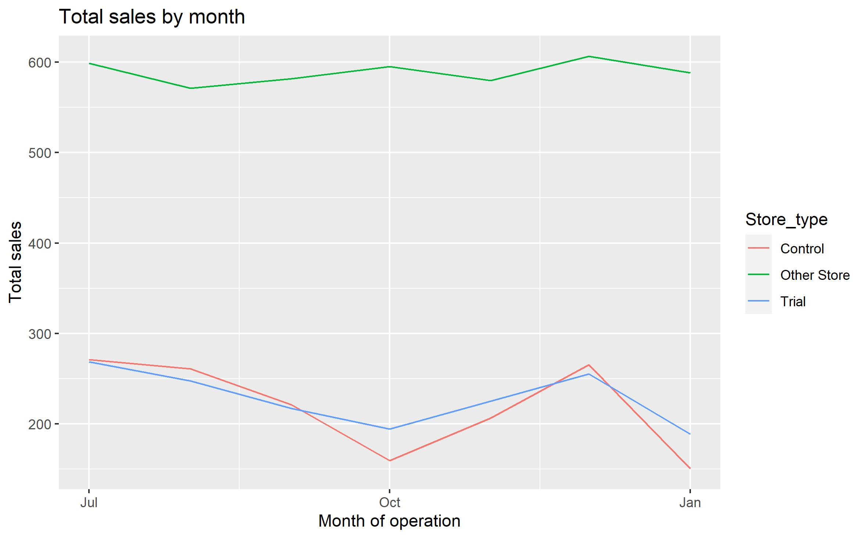
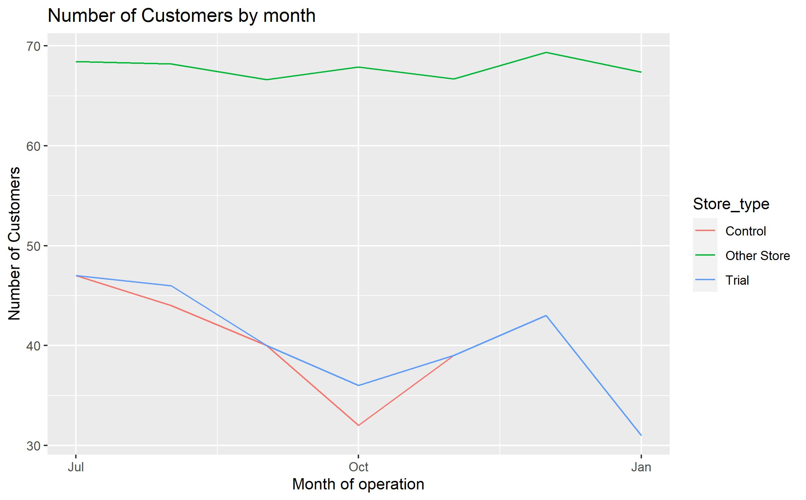
Explanation of the control store vs other stores
Trial Store 77 was compared to Control Store 233 due to its similarities prior to the trial period.
How the control store was determined:
To determine the control store, I use 2 measures to score each store based on their correlation and magnitude distance between the trial store and control store. To determine a final score, I used a weighted average and ordered final score in descending order.
From Table 3, Chart 6 and Chart 7 it can be concluded that store 233 is our control store as it shows the most similarities in sales and customer size to the trial store
Table 3
Trial Store | Control Store | Trial Store
77 | 233 | 0.9777796
77 | 50 | 0.8889665
77 | 35 | 0.8497934
77 | 254 | 0.8321038
77 | 41 | 0.8084115
77 | 167 | 0.8081593
Chart6: Total Sales by Month (Control Vs Trial Store)
Chart7: Total Customers per Month (Control Vs Trial Store)
Similarly, Control store 233 and Trial store 77 also very similar number of customers in the pre-trial period
Control store 233 and Trial store 77 show very similar sales pre-trial period
R Studio Code: Lines 18 – 229

Slide 12
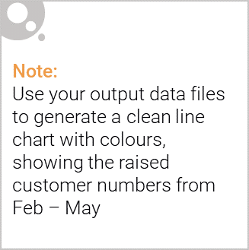
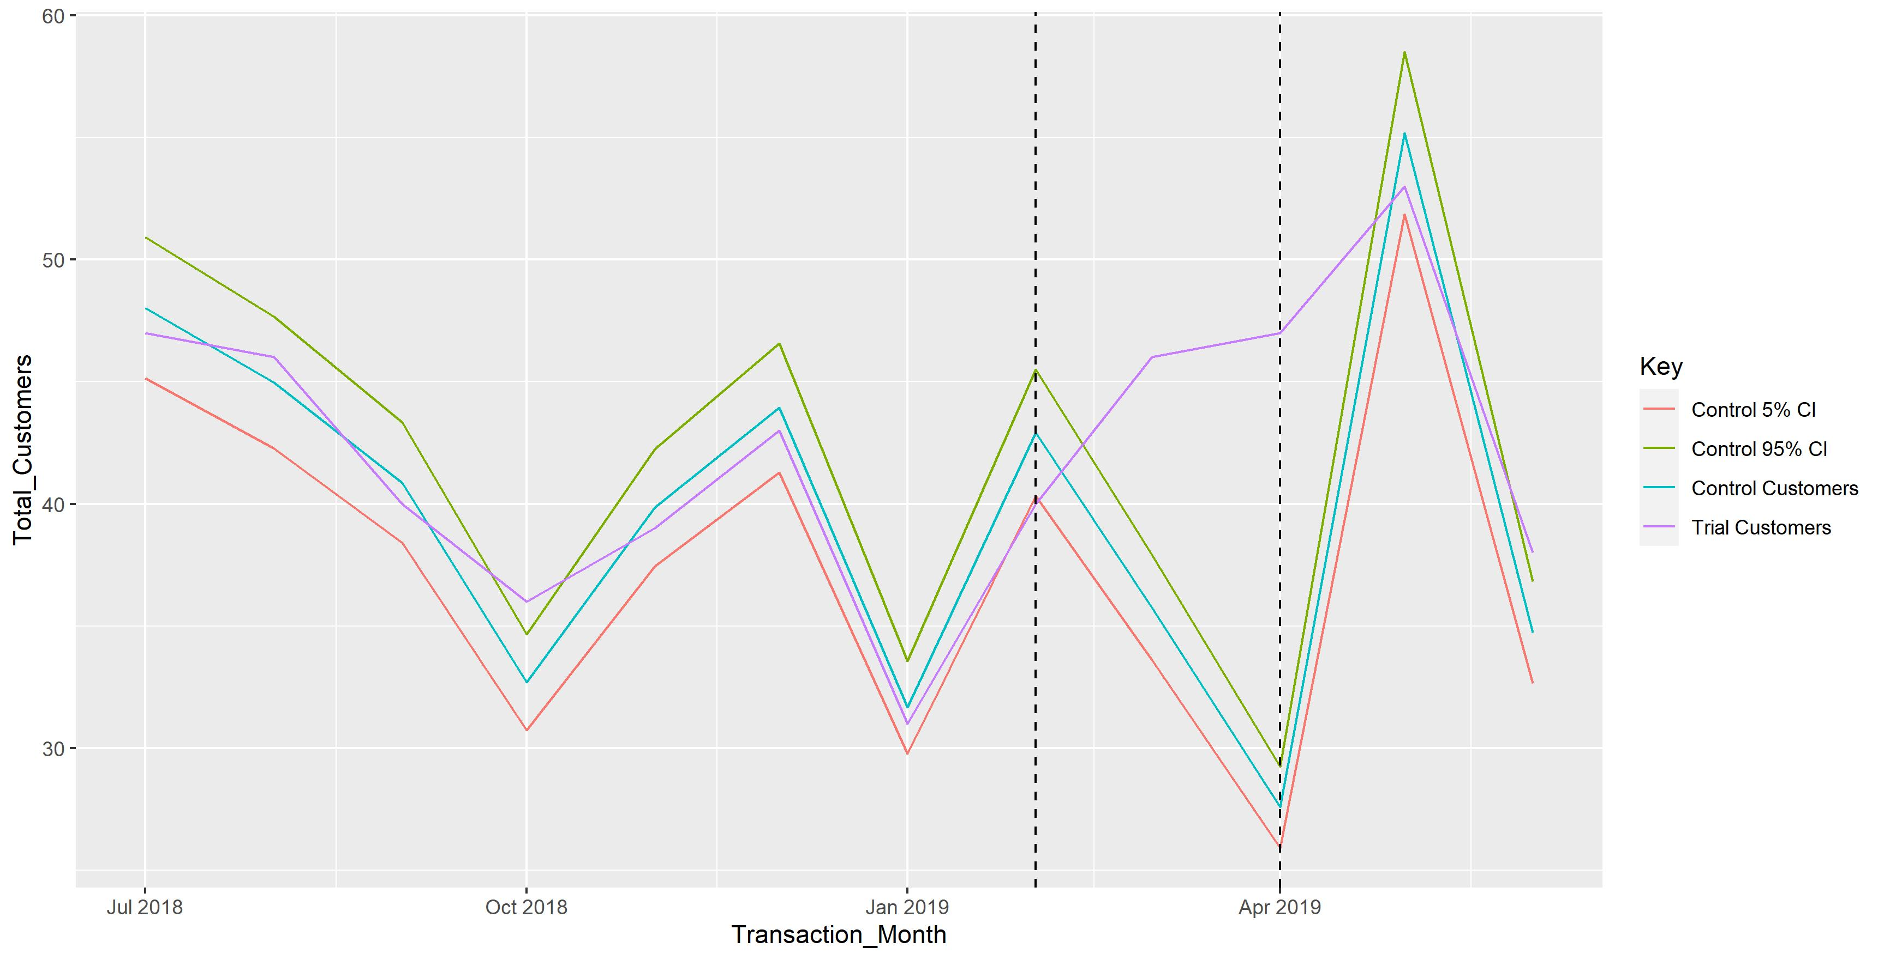
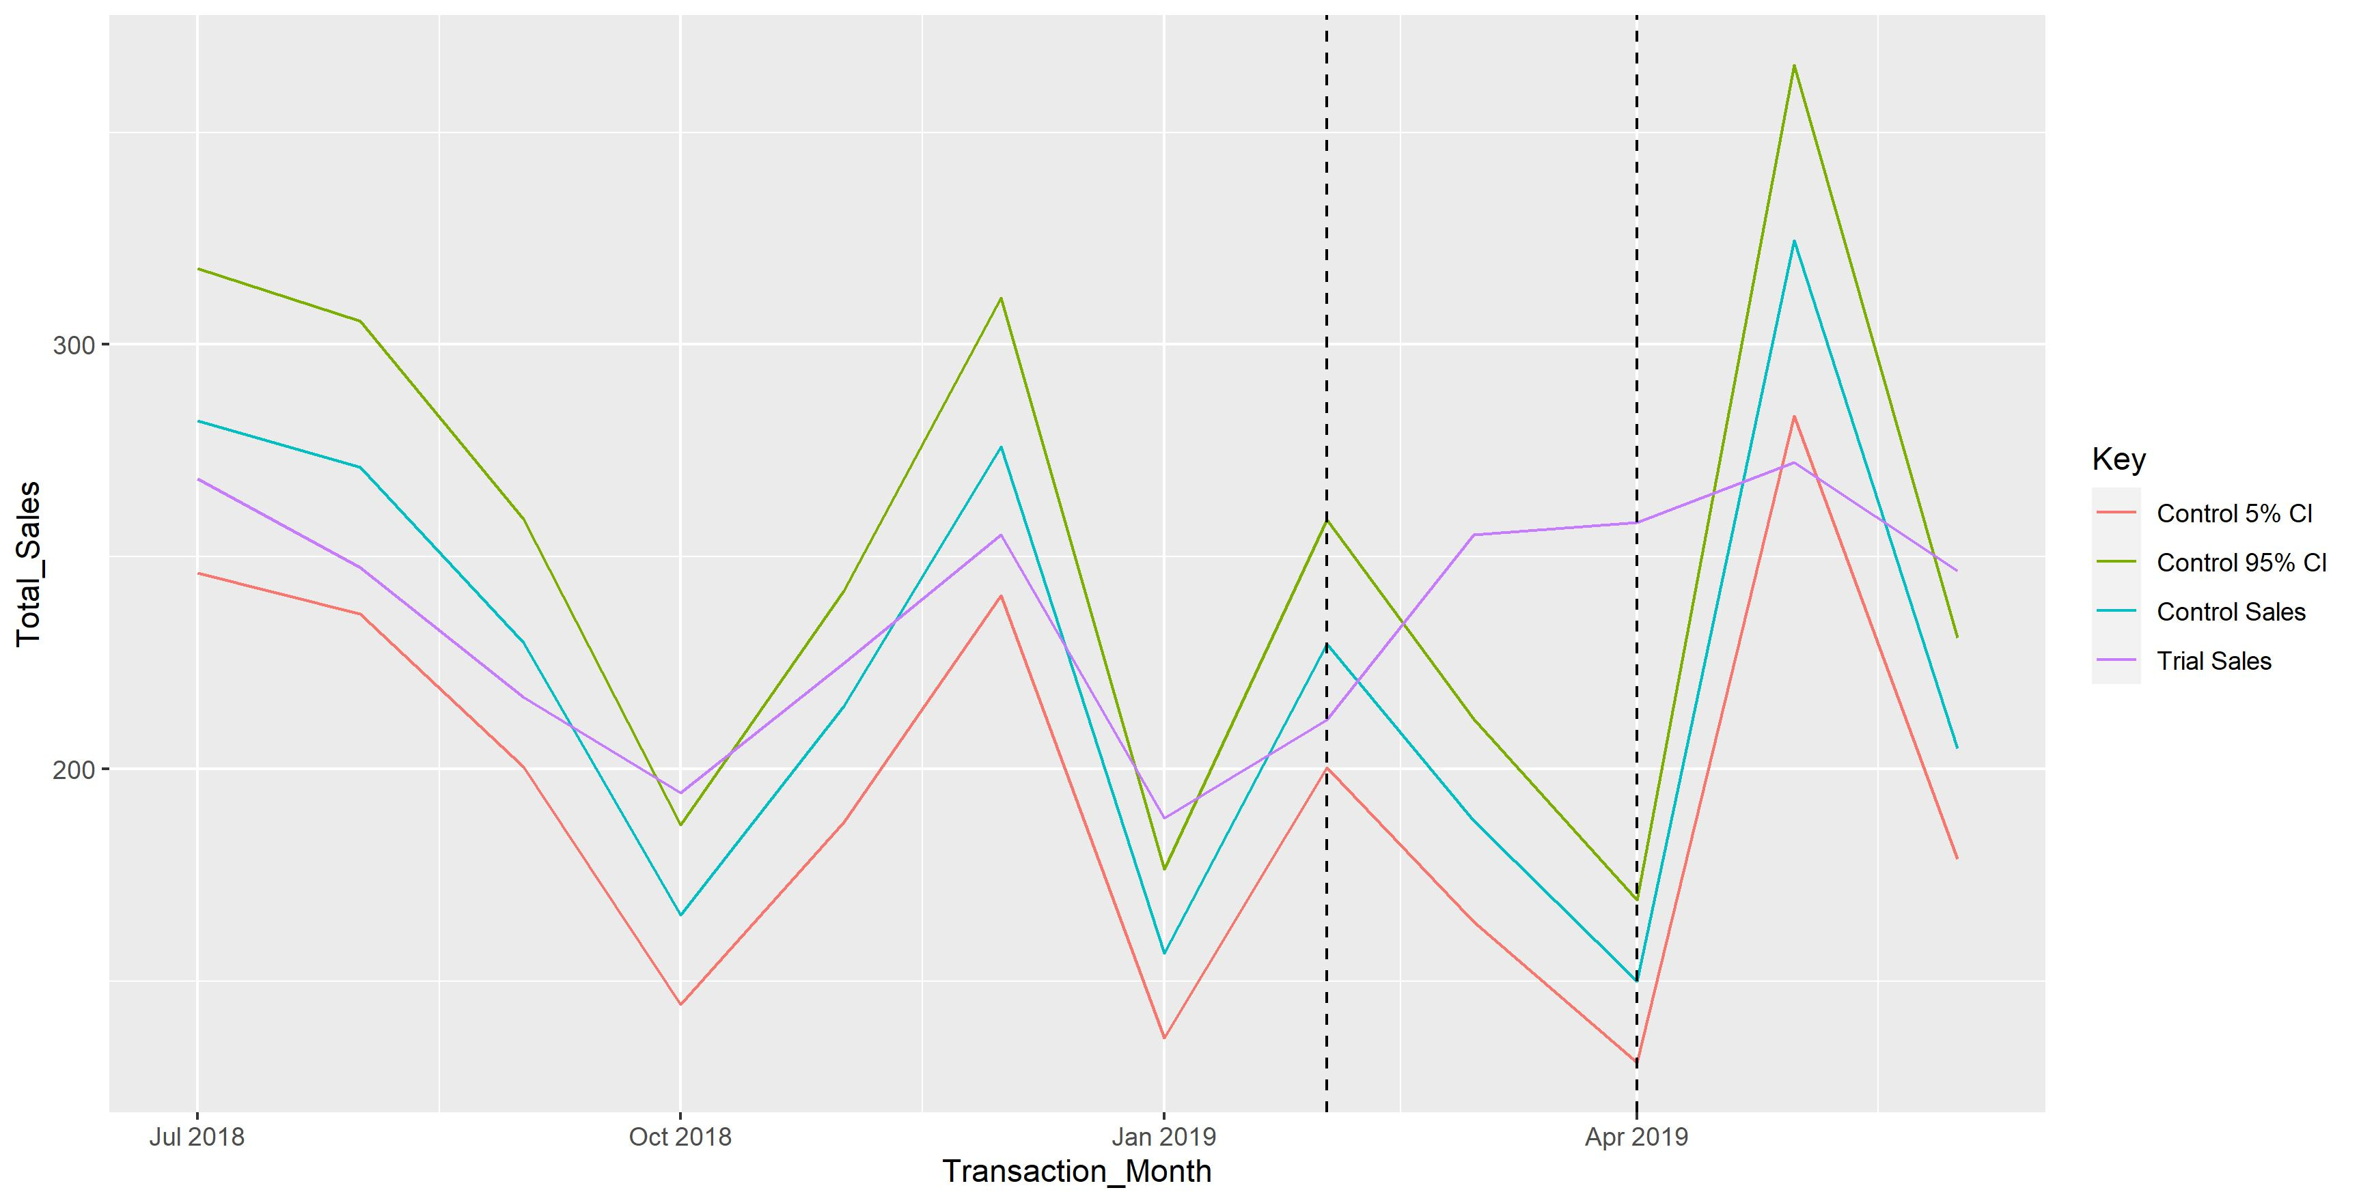
Trial Store Performance
Trial Store 77 outperformed Control Store 233 in both Customers and Sales over the trial period
Conclusion:
Trial Store 77 saw a significant increase in Sales in the month of March and April (Trail period) as seen in Chart 8. This was also supported by the increase in customers as the trial store compared to the control store in Chart 9. Concluding that the new trial layout had significantly improved sales and the number of customers purchasing chip packets at store 77.
Chart7: Total Customers per Month (Control Vs Trial Store)
Chart7: Total Customers per Month (Control Vs Trial Store)
Trial Period
As seen in both Chart 8 and Chart 9, Trial Store 77 saw a significant increase in sales and number of customers compared to the Control Store which saw a decline in sales and number of customers over the trial period.
Trial Period
R Studio Code: Lines 233 – 283

